Slide 1

Health and Fitness
DIVYANSH SRIVASTAVA

Slide 2

How to make any habit Permanent?

Slide 3
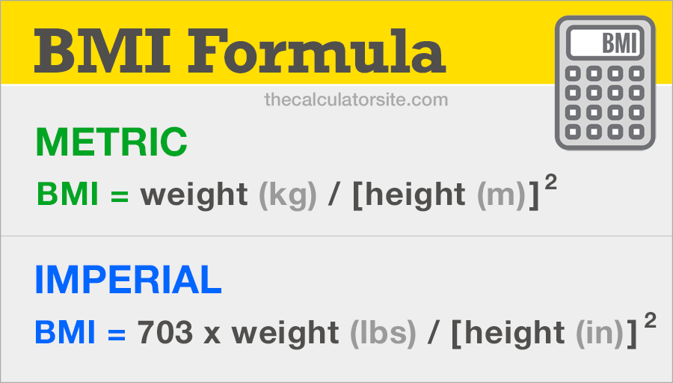
How to measure whether you are healthy or not?

Slide 4
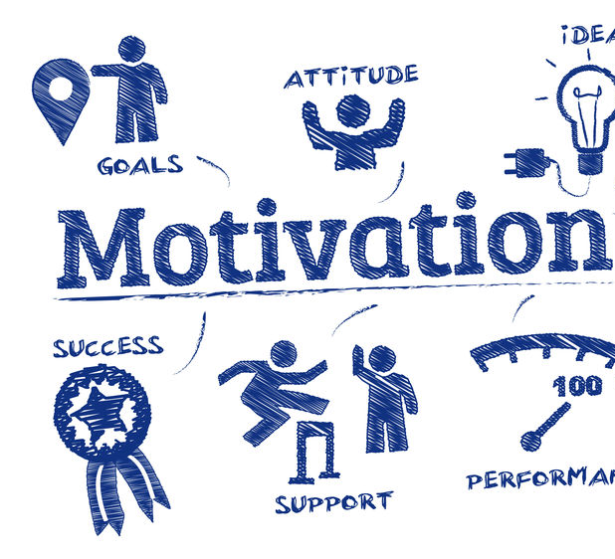
MOTIVATION FACTOR

Slide 5

First thing we see when we meet But LEAST, we think about it as we start AGEING?

Slide 6



FACE

Slide 7
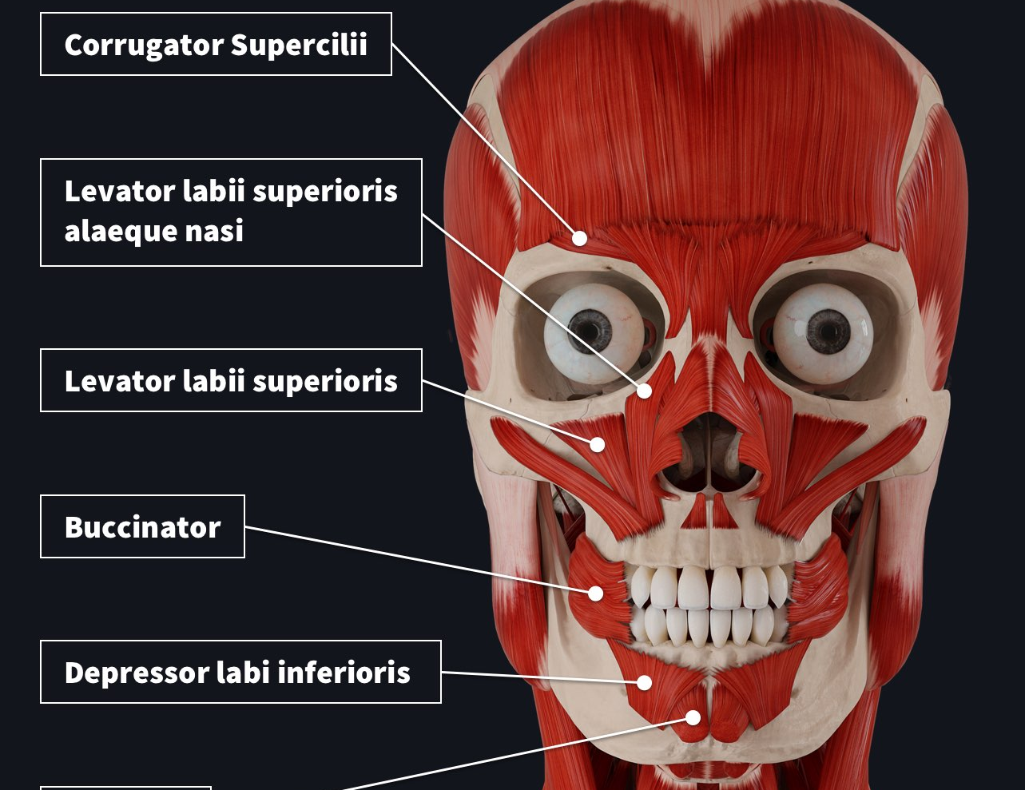
FACE FACT 1:
The human face has 43 muscles involved in expressing facial emotions

Slide 8
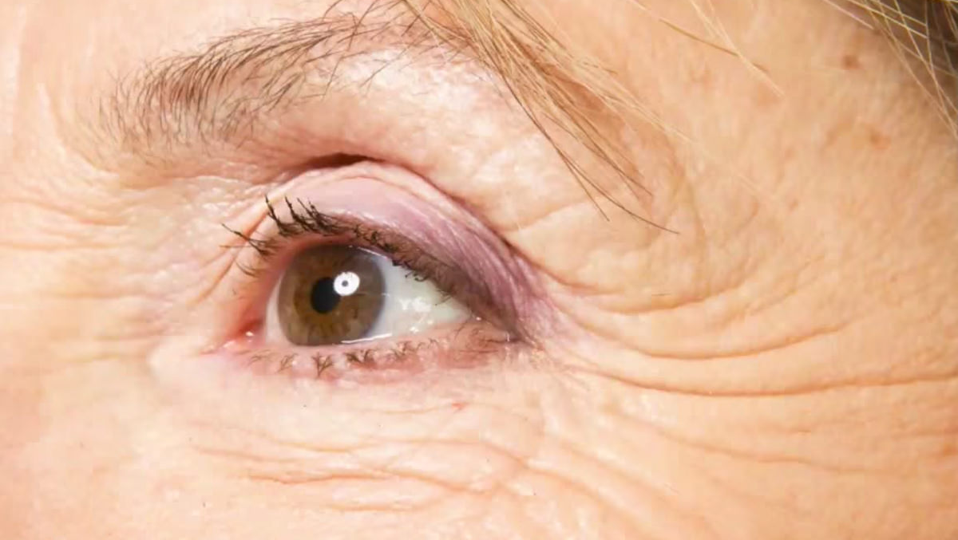

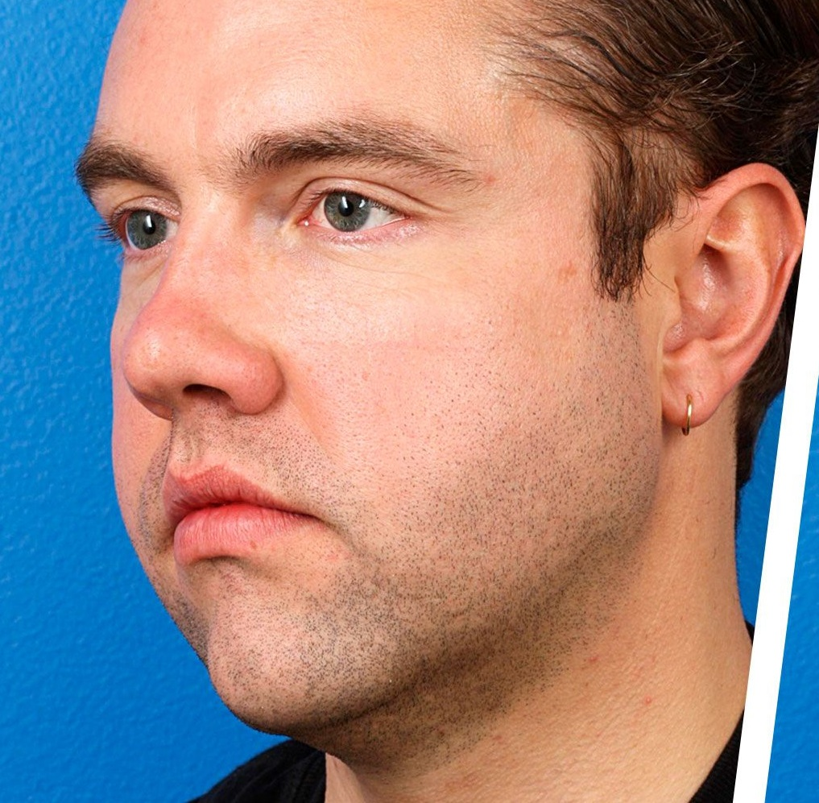
Problems regarding face

Slide 9

FACE FACT 2:
Only 12 muscles are active when smiling

Slide 10
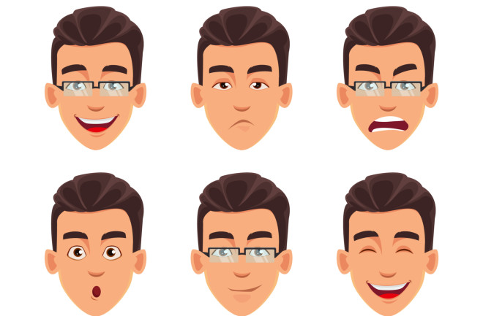
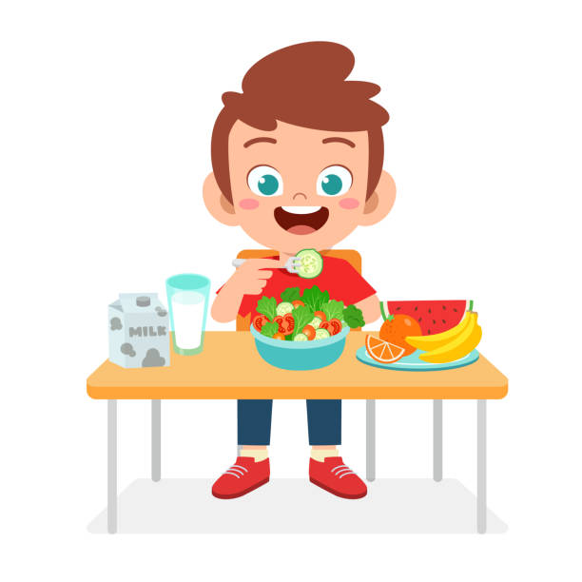
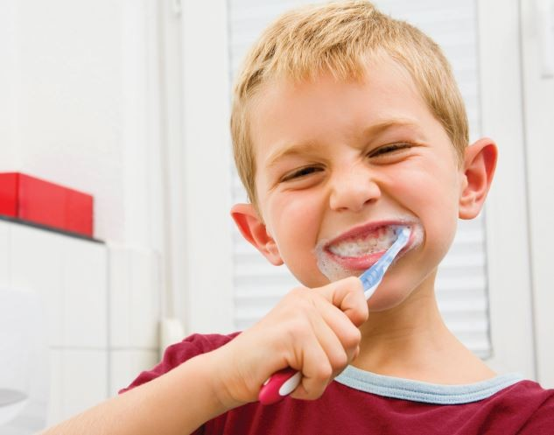
REASON Behind face problems
Not doing any facial exercises.
Facial Exercise only happening
Facial Expressions
Brushing Teeth
Eating Food

Slide 11

FACE FACT 3:
A frown only uses 11 muscles.

Slide 12
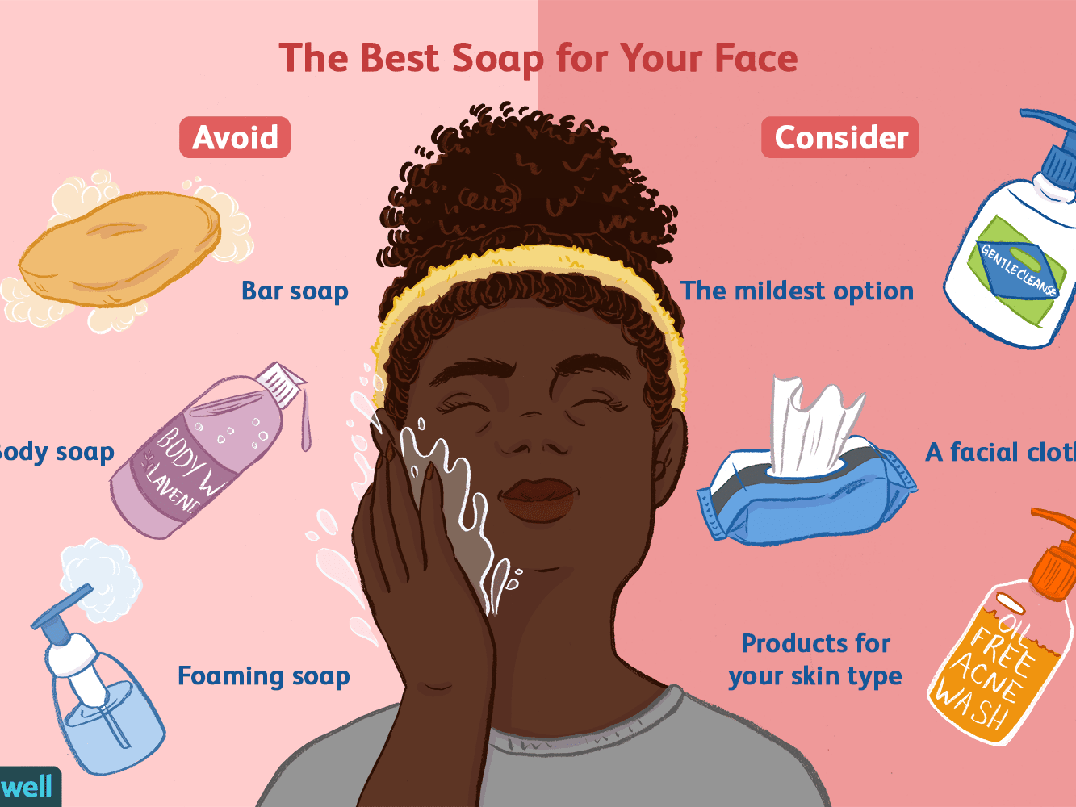
Tip 1: AVOID using soap for face and start using face wash
Soap is alkaline-based, but your skin is acidic
The alkaline nature of the soap bar can cause your face to become dry and strip away the natural moisture. If you apply soap regularly on the face, it may turn flaky and itchy or become prone to breakouts.
Do some exercise as well while using any face washes.

Slide 13

FACE FACT 4:
A birth defect that is otherwise known as the dimple.
Dimples are genetic defects

Slide 14
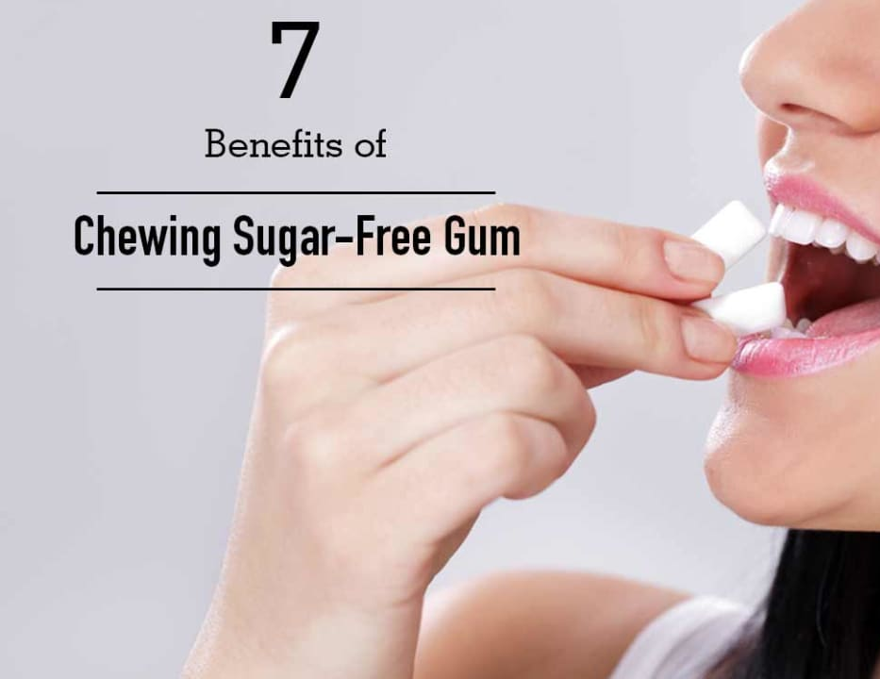
TIP 2: CHEWING GUM
puts eight different muscles of the face and neck in action
reducing double chin
helps in achieving that dream jawline
Prevents Cavities and Improves Oral Health
Eases Acid Reflux
Lowers Stress and Anxiety
Prevents Dry Mouth and Freshens Breath
chewing gum cannot reduce fat deposits found in your double chin

Slide 15
BONUS for chewing gum
Helps manage weight by improving eating habits
Chewing gum is a good way to keep your cravings at bay when you are trying to lose weight. Popping a sugar-free gum when you feel cravings for a sugary snack is a good way to immediately reward yourself without all the additional calories and tricking your brain according to studies. This is also an excellent way for you to stop yourself from mindless nibbles of high-calorie snacks while watching TV or relaxing. Therefore, if you’re looking to ward off your food cravings, grab a stick of gum instead of a sugary treat to cut out all the unnecessary calories.

Slide 16

FACE FACT 5:
The tongue is the only muscle in the body attached to one end.

Slide 17
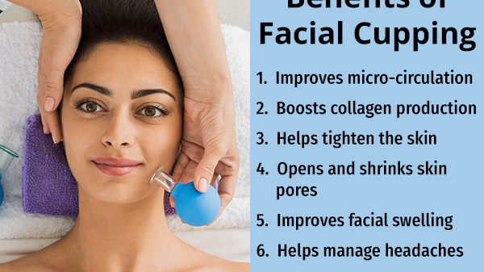
TIP 3: FACIAL
More than 75% facial is just the exercise for face skin.
Reduces Stress

Slide 18

THANK YOU

